Slide 1

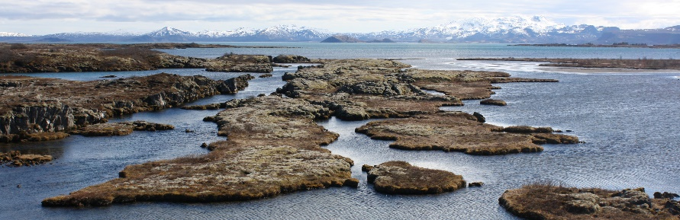
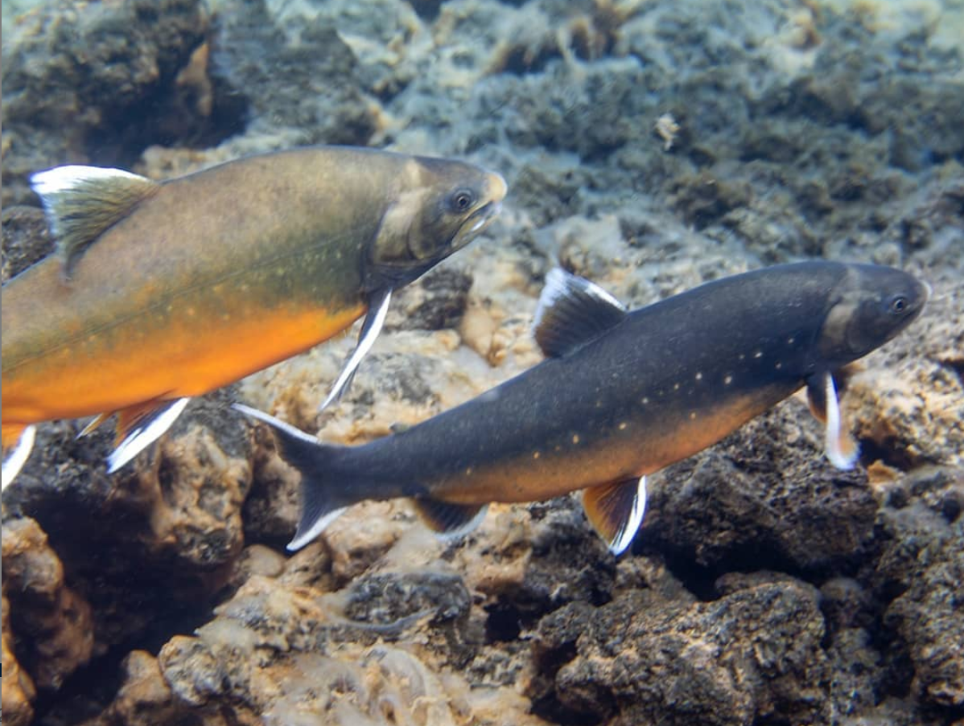
Marina de la Cámara
PhD candidate, University of Iceland.
Advisors: Kalina H. Kapralova (HÍ) & Michael Morrisey (U. St Andrews)
Research interests: evolutionary biology, adaptive divergence, hybridization, speciation.
The genomic basis of adaptive differentiation between closely related morphs of Arctic charr in lake Þingvallavatn
Figure: Quentin Horta
Notes:
Single colonization event after last glaciation
Subsequent divergence into four morphs
Different trophic preferences → occupy different niches → differences in morphology of the feeding apparatus and other traits
Diverging life history traits, parasitic loads, behaviour
Resource polymorphism (adaptive divergence)
Benthic-limnetic axis
Product of a genetic component and phenotypic plasticity.

Slide 2
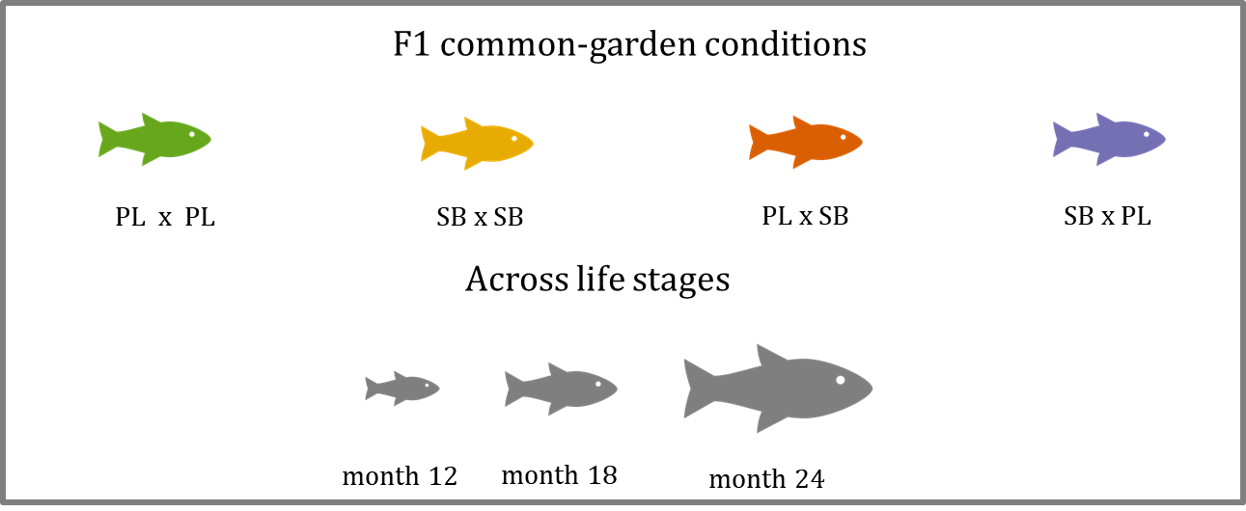
Identify genomic regions associated with complex adaptive traits, associated mainly with trophic preferences
I will combine QTL mapping and population genomic methods
Need of exploring phenotypic platforms to identify major axes of variation between morphs → GMM + linear measurements + coloration…
QTL families set up: families grown in common garden conditions
Common garden conditions → develop a phenotyping platform + studying differences during ontogeny
What’s driving shape for the whole set of individuals? Morph? Life stage?
How early can we detect differences between pure crosses? And hybrids?
Are hybrids intermediate in the morphospace? For each life stage?
Are there differences between reciprocal hybrids (i.e. PLxSB and SBxPL)?

Slide 3
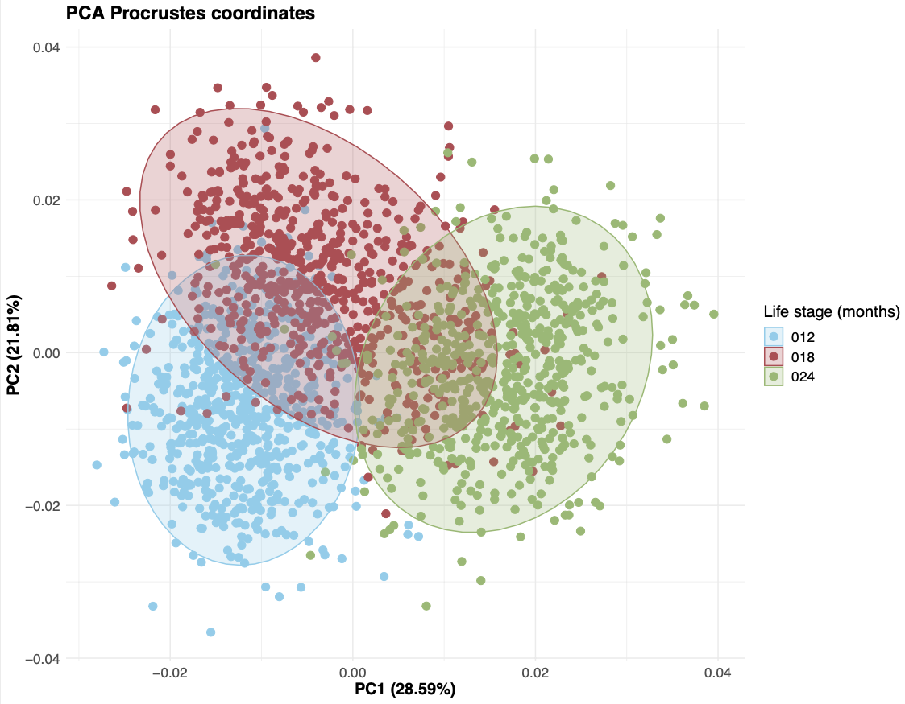
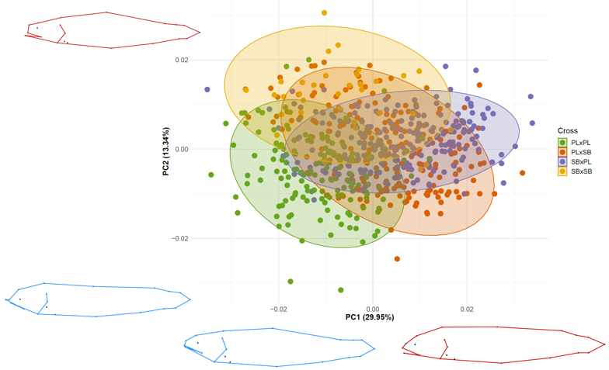
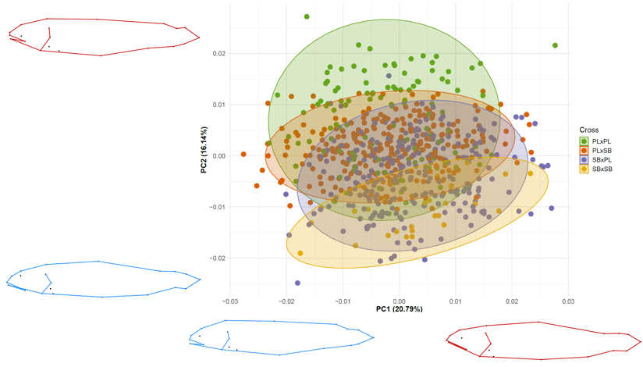
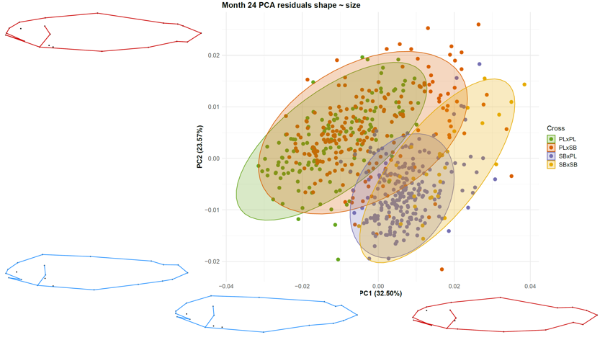
What’s driving shape variation?
Individuals group nicely by life stage…
But when we examine each of them…
Month 18. Hybrids both intermediate and extreme
Month 24. Pure crosses separated.
Hybrids overlap with their respective maternal phenotype
Month 12. Hybrids intermediate in morphospace
Notes:
When all individuals are pooled together they tend to group by life stage...
But when we examine each of them:
Month 12: Hybrids look intermediate but reciprocal crosses tend to overlap with their parentals.
Month 18: Some of th hybrids still look intermediate but many are extreme at high values of PC1.
Month 24: Pure crosses don‘t share morphospace anymore! Hybrids tend to overlap with their respective maternal phonotype (but each of them in a different way) and show extreme phenotypes.

Slide 4

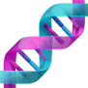
Conclusions
Strong genetic component of morphology
Differences between morphs become more pronounced with growth
Reciprocal hybrids appear to be intermediate at early stages…
…but start diverging towards their respective maternal phenotypes or show transgressive (outside of the parental range) morphological traits.
If there’re hybrids in the lake they probably look like their mothers.
What do I want to learn next?
Using geomorph at the moment
Deepen my knowledge in multivariate analysis (interpret geomorph outputs correctly, play with RRPP options…) before I expand my data set and select traits for mapping
Thanks for listening!

